Slide 1
Objectives
In this session, you will learn to:
  Appreciate message-based communication

Slide 2

Introduction to Service Broker
What is a Service Broker?
Notes:
Refer SG to explain

Slide 3

Introduction to Service Broker (Contd.)
A Service Broker is a message-based communication platform.
Notes:
Refer SG to explain

Slide 4
Introduction to Service Broker (Contd.)
Service Broker:
  Helps in maintaining reliable query processing and asynchronous communication.
  Allows the database developers to create services that converse with each other by sending and receiving messages.
  Is a database object that provides an endpoint for a conversation.
  Sends a request message to another service to utilize the provided functionality.
Notes:
Refer SG to explain

Slide 5
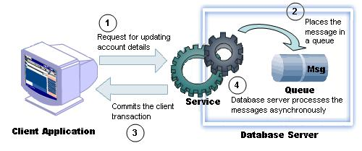
Introduction to Service Broker (Contd.)
Working of Service Broker:
Notes:
Refer SG to explain

Slide 6
Introduction to Service Broker (Contd.)
The following list represents the usage of Service Broker in business processing:
  Asynchronous triggers
  Reliable query processing
  Reliable data collection
  Distributed server-side processing for client applications
  Data consolidation for client applications
  Large-scale batch processing
Notes:
Refer SG to explain

Slide 7
Introduction to Service Broker (Contd.)
Let us discuss about Service Broker architecture.
Notes:
Refer SG to explain

Slide 8
Introduction to Service Broker (Contd.)
Service Broker architecture:
  Consists of the following database objects:
    Message
    Service
    Message type
    Contract
    Queue
    Service program
Notes:
Refer SG to explain

Slide 9
Introduction to Service Broker (Contd.)
Service Broker architecture:
  Consists of the following database objects:
    Message
    Service
    Message type
    Contract
    Queue
    Service program
Is the data exchanged between services
Notes:
Refer SG to explain

Slide 10
Introduction to Service Broker (Contd.)
Service Broker architecture:
  Consists of the following database objects:
    Message
    Service
    Message type
    Contract
    Queue
    Service program
Is an addressable endpoint for the conversations
The two types of services that take part in a conversation are initiator service and processing service.
Notes:
Refer SG to explain

Slide 11
Introduction to Service Broker (Contd.)
Service Broker architecture:
  Consists of the following database objects:
    Message
    Service
    Message type
    Contract
    Queue
    Service program
Defines the content of the messages exchanged between the participants in a conversation
Notes:
Refer SG to explain

Slide 12
Introduction to Service Broker (Contd.)
Service Broker architecture:
  Consists of the following database objects:
    Message
    Service
    Message types
    Contract
    Queue
    Service program
Is an agreement between the two services about the messages exchanged between them
Notes:
Refer SG to explain

Slide 13
Introduction to Service Broker (Contd.)
Service Broker architecture:
  Consists of the following database objects:
    Message
    Service
    Message types
    Contract
    Queue
    Service program
Is a container that stores messages
It is represented in the form of a table where each message is placed in a row.
Notes:
Refer SG to explain

Slide 14
Introduction to Service Broker (Contd.)
Service Broker architecture:
  Consists of the following database objects:
    Message
    Service
    Message types
    Contract
    Queue
    Service program
Is a program that provides logic to the service
Notes:
Refer SG to explain

Slide 15
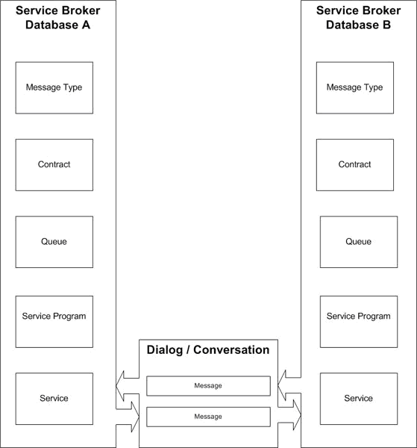
Introduction to Service Broker Conversation Process
Service Broker conversation process:
Notes:
Refer SG to explain

Slide 16
Introduction to Service Broker Conversation Process (Contd.)
Flash presentation: Implementing Service Broker
Notes:
Refer SG to explain

Slide 17
Introduction to Service Broker Conversation Process (Contd.)
The conversation process between two services in Service Broker includes the following objects:
  Dialog
  Conversation group
  End points
  Routes
Notes:
Refer SG to explain

Slide 18
Introduction to Service Broker Conversation Process (Contd.)
The conversation process between two services in Service Broker includes the following objects:
  Dialog
  Conversation group
  End points
  Routes
Is a two way conversation between two Service Broker services
Notes:
Refer SG to explain

Slide 19
Introduction to Service Broker Conversation Process (Contd.)
The conversation process between two services in Service Broker includes the following objects:
  Dialog
  Conversation group
  End points
  Routes
Is a collection of related dialog conversations
Notes:
Refer SG to explain

Slide 20
Introduction to Service Broker Conversation Process (Contd.)
The conversation process between two services in Service Broker includes the following objects:
  Dialog
  Conversation groups
  End points
  Routes
Allow a Service Broker to communicate over the network using transport protocols, such as HTTP, TCP, and SOAP
Notes:
Refer SG to explain

Slide 21
Introduction to Service Broker Conversation Process (Contd.)
The conversation process between two services in Service Broker includes the following objects:
  Dialog
  Conversation groups
  End points
  Routes
Determine the destination of a message
Notes:
Refer SG to explain

Slide 22
Just a minute
Which of the following objects processes a message from a queue?
  Service
  Service program
  Contract
Solution:
  Service program

Slide 23
Summary
In this session, you learned that:
  Service Broker provides a platform that allows the developers to create asynchronous and reliable query processing.
  In Service Broker, developers create services that converse with each other by sending and receiving messages.
  The following list represents the usage of Service Broker in business processing:
    Asynchronous triggers
    Reliable query processing
    Reliable data collection
    Distributed server-side processing for client applications
    Data Consolidation for Client Applications
    Large-Scale Batch Processing
  A message is the data exchanged between services.
  Each message is of a specific message type.
Notes:
You can summarize the session by running through the summary given in SG.
In addition, you can also ask students summarize what they have learnt in this session.

Slide 24
Summary (Contd.)
  A service is a database object that provides an endpoint for a conversation.
  A contract is an agreement between the services that participate in a conversation.
  Each service is associated with a queue that acts as a container that stores messages.
  A service program provides the required service to which a message is forwarded by the queue for processing.
  The conversation process between two services in Service Broker includes the following objects:
    Dialog
    Conversation Groups
    End Point
    Routes
Notes:
You can summarize the session by running through the summary given in SG.
In addition, you can also ask students summarize what they have learnt in this session.

